Slide 1
Alternate Method to satisfy ACCA Manual S Compliance
( FREE INSTRUCTOR SOFTWARE
- SEE LINK ON LAST SLIDE )
Flexible and streamlined alternative method to ACCA’s Manual S basic calculations
Presented by Prof. Kenneth Ripberger, CMHE
Notes:
LOOK FOR SPEAKER’S NOTES ON SOME SLIDES!

Slide 2
Disclaimers:
This presentation is not affiliated with Delgado Community College, Louisiana.
This is only a THEORY of a potentially successful method.
The author is willing to deliver complete transparency of results and method, but retains the right to the same protection of computational formulas as some manufacturers maybe enjoy.
Any historical information is from actual NESCA / ACCA hard copy manuals.

Slide 3
Pre-1966, HVAC designs were custom made to ASHRAE standards
Notes:
HVAC design existed in commercial building design for decades, done by mechanical engineers or manufacturers. They have used complex formula methods for SHR needs and performance; for mixed-air, economizers, reheat, internal loads, and other assorted factor corrections on custom jobs This then set the duct sizing, which is the third piece to come full circle and cause a wonderful expensive design cycle.
The American Society of Heating, Refrigeration, and Air-Conditioning Engineers pretty much ran the show.

Slide 4
Trying to complete the circle: After 1966, NESCA, ARI, and SMACNA began collaborating on the residential HVAC simpler designs (J, S, & D respectively)
Notes:
But residential didn’t need all the equipment specs that commercial did, and left it out.
In 1966, manufacturers and engineers custom started work on the working design circle for residential.
National Environmental Systems Contractors Assoc.
The Air Conditioning and Refrigeration Institute.
Sheet Metal and Air Conditioning Contractors Assoc.
At that time, NESCA Manual C simply said that “some moisture is condensed out”…”supply air leaves the cooling coil at a lower temperature and with less moisture”.
So until the 80’s, there remained a missing piece in residential design.

Slide 5
What is required in 39* states right now!
Design:
Room-by-Room Heat Gain/Loss Calculation
Ductwork Sizing Calculations
Residential Equipment Selection Calculation (the above three items are required to be done by methods laid out by ACCA® Manual J, D, and S respectively, or other APPROVED method) IRC 2009, M1401.3, M1601.1
Can there be error and even tom-foolery? Sure!

Slide 6
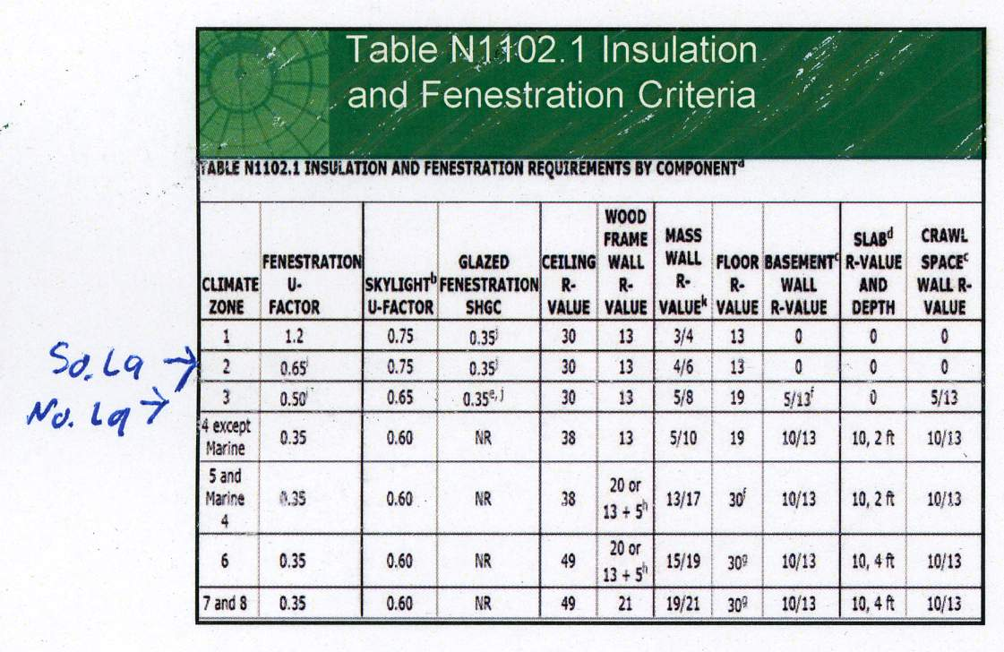
What is required varies:
Courtesy: Marc Roberts - ICC
Notes:
There are 7 or 8 climate zones in the US.
We will see how that in a few minutes.

Slide 7
Of COURSE Manual J can be abused. (“Gaming” the report barely at guidelines)
Excessive internal loads: worst case, everything going full blast
No internal shade on any windows
Reducing known insulation R-values to wrong zone
Extra occupancy loads. Using old 2 per bedroom rule
Notes:
Follow the zone requirements!

Slide 8
Keep going…..
“Loose” house, using 7 ACH @50p to barely meet code
Using higher outdoor design temperature than stated in manual
Using indoor temperatures that are actually lower for summer than in winter
High default leak values on ducts, with wrong R-value

Slide 9
And the ducts:
Everything at 0.1 static, that’s as bad as the “400 sq., ft per ton” thing!

Slide 10
What was Beethoven thinking?
“What is in the MIND of a composer”, creating something from nothing?
Listen to music, there’s something they are trying to put into words, it can be hard to know. Like test questions.
Notes:
(from the movie “Immortal Beloved”, 1994)

Slide 11
So what was Rutkowski thinking?
Why did he feel we still needed closure after Manual J in 1967?
Perhaps it was when the “30% latent load for everywhere” standard changed.
So he started to see what gap that left open, about 30 years ago.
Notes:
There was no easy contractor method yet to figure required airflow for SHR comfort,
or even equipment capacity change, when the change of conditions now mattered.

Slide 12
HVAC is not a static process
The structure has heat removal NEEDS, and you’ve got the maximum sensible and latent in your load calculation done,
AND YET:
Different climates OFFER UP heat to HVAC systems for removal, in different ways, and at varying times.
Removing the “30%” rule of thumb meant system PERFORMANCE would vary too.
Notes:
There was now the need to determine capacity of equipment, to match the sensible and latent heat load needs of structures from Manual J, for best comfort under other climates than “30%”. (=.70 SHR)

Slide 13
What WAS that really?
The “30%” was a .70 SHR
(which is fine for swampland like NOLA)
SHR is “Sensible Heat Ratio”.
Maybe we all knew that term, but how could we ensure, when all was said and done that we wouldn’t dry out, or moisten the job too much?
Notes:
The residential contractor’s ability to determine capacity of equipment, to match the sensible and latent heat load needs of structures from Manual J, for best comfort under most climates was needed.
And it was a SWAG to know the airflow of the selected equipment, needed to create this SHR (sensible to latent ratio), and when to adjust it.
Residential was moving too fast to be concerned with accuracy; there was already plenty of “wiggle room”, and few complaints.
So we just left fans on the default high speed.

Slide 14
Residential misdemeanors
I tell my students on day-one:
“Don’t sweat the details, tighten your data where it’s important in your climate zone, you can just take defaults on the rest”.
The wiggle room will be there, due to limited residential equipment offerings.
Notes:
Cooling is in 6,000 Btu increments, heating is in 20,000 Btu increments.
So being off by 1 on an R-value is meaningless at the end of the day, down south, but matters more up north.

Slide 15
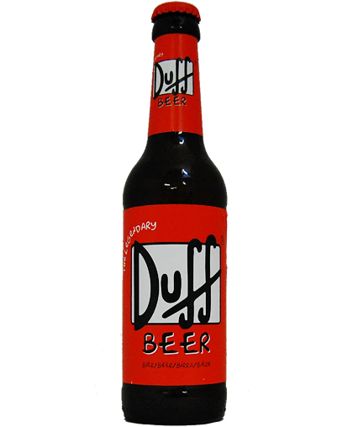
Sometimes Latent heat removal is not always an issue
A cold bottle of beer does not always need a coaster!
It won’t sweat in dry air.
Notes:
And you may have a situation where no removal of moisture will happen, or is needed, like perhaps Las Vegas?

Slide 16
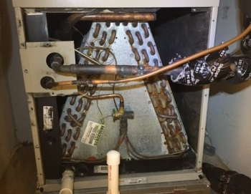
Neither will a cooling coil. Is dry ok?
Sure, if there’s very little moisture in the air to remove.
(Notice minimal coil rusting in dry climates.)
Notes:
If this is a running system, the SHR would be 100%, since no moisture is being visually removed.
The airflow may have been set high to maximize compression cycle efficiency in a dry climate.
This will also help avoid the removal of what moisture is present, to maintain comfort.

Slide 17
But there might be a lot of water in the air
It would follow then, that HVAC cooling coils will remove more water from air, when there is more there to remove!
Notes:
The equipment may need to remove a lot moisture in the deep south.

Slide 18
=
“You need a coaster for that dear!”

Slide 19
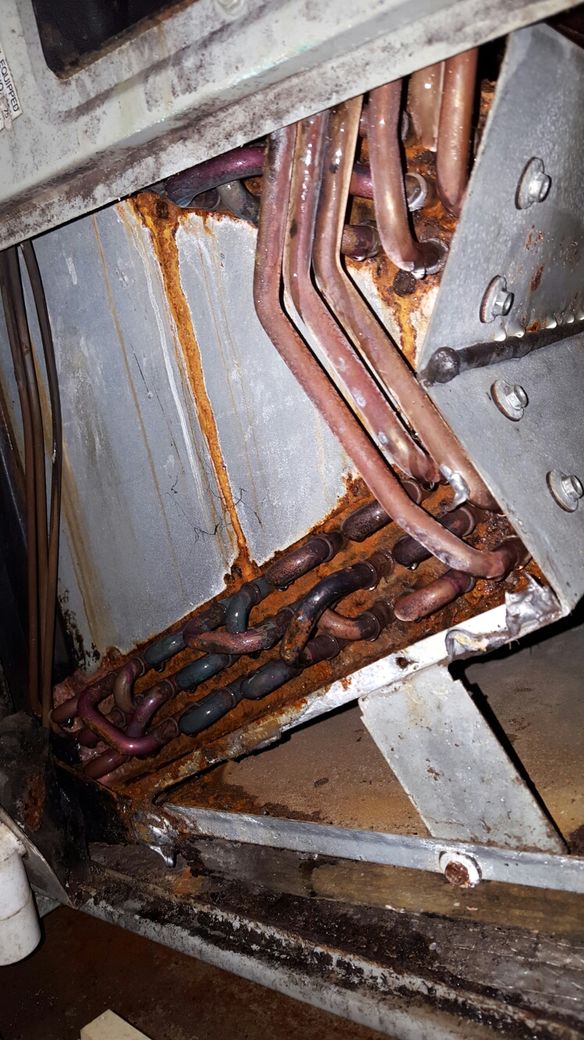
Coils in humid climates
There will also be more corrosion from non-stop water draw out of humid air.
Notes:
And airflow needs to be adjusted to handle the moisture load, with precision.
This also requires better determination of that in the load calc., not just a wild guess.

Slide 20
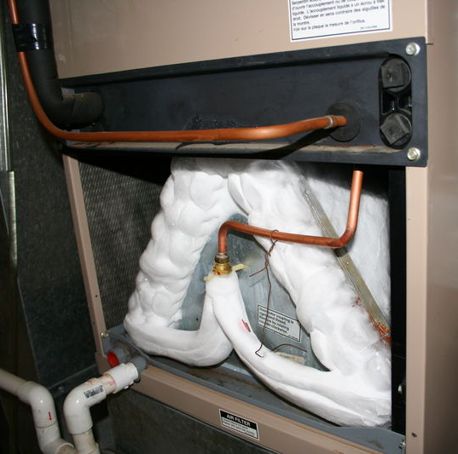
How to collect latent faster!
With very low airflows, you will remove a lot of water, but this only works up to a certain magic point!
Notes:
The airflow of the selected equipment is needed to create this SHR (sensible to latent ratio), and when to adjust it.
And the limitations of that.

Slide 21
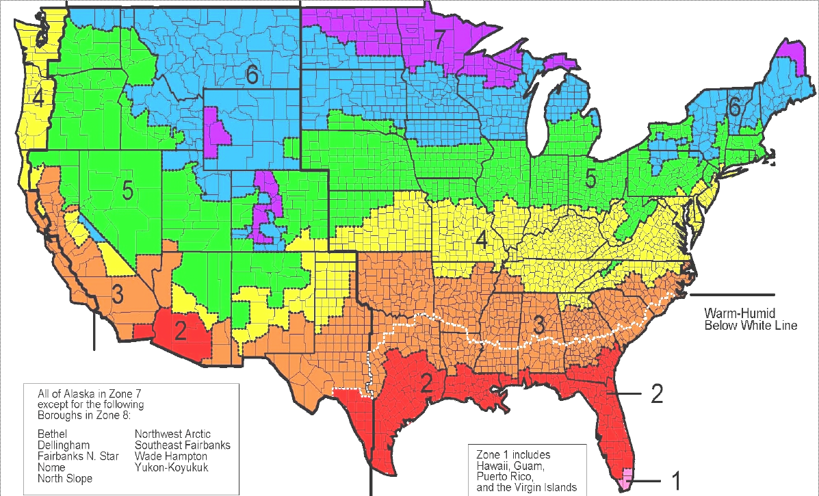
Equipment abilities
No manufacturer is going to make seven versions of each model to handle the zones.

Slide 22
Variations really go beyond the 7 zones thing though
So we have to figure how equipment will be affected by ANY outdoor / indoor climates, and choose / adjust what is available.
It’s very predictable though, the laws of science affect anyone’s HVAC equipment almost the same.
So the effect of variation could be CLOSELY predicted.
AND MUCH CLOSER THAN THE SWAGS (scientific wild-as* guesses) MADE SO FAR!

Slide 23
So, to be useful the “S” method should be able to:
1. State what the house needs.
2. State what a particular unit can do at AHRI test conditions.
3. Prove the ability to interpolate what that unit can do at your conditions.
4. Declare whether the unit is over or undersized for your house per standard industry guidelines.

Slide 24
Manual S – ACCA method
It’s very complex and time consuming, even with Elite Rhvac’s tool.
It requires expanded data….. And a spreadsheet, Get ready!

Slide 25
Numbers for Every orange cell must be pulled from an expanded data chart. Go find another chart if size isn’t good

Slide 26
Harvesting Numbers
You’ll need a data chart like this next slide for that treasure hunt of numbers:
(2-stage Amana older sample 60-page booklet for one model size shown)
assuming you can get the chart!

Slide 27
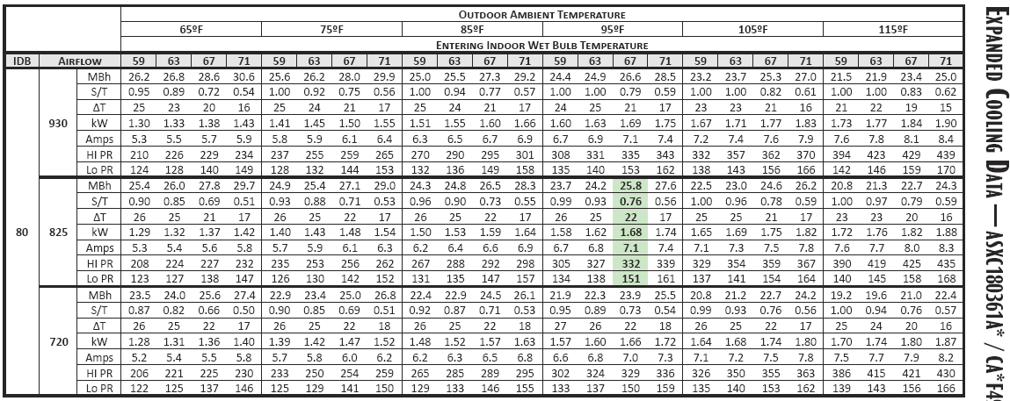
Data for one model’s size:

Slide 28
J-error, D-error, and….
DO WE REALLY NEED MORE ERROR?
The door to gaming abuse stays open and can now be continued. It’s unlocked AND WIDE OPEN, in Manual S, because human error is exacerbated in the method.
Notes:
The “wild west” part of design.
Who’s going to audit the process?

Slide 29
How to get expanded data: Documented true story! (names withheld)
In the Summer of ‘15, I requested data from a distributor that knew me (largest in the State for that brand). But they didn’t know what expanded data looked like.
After 2 days, sent me an AHRI sheet! I sent then a sample of another brand’s data.
After the 3rd day, their sales manager sends me another AHRI rating sheet!
On the 4th day, their technical rep. asked me to come show THEM on their computer how to find what it is! I wasn’t going to do that!
At 5pm of 4th day, their corporate office figures out how to isolate the data I need, and they send it to me direct.

Slide 30
Equipment Selection
Wrightsoft was generating expanded data, with each brand’s “measured data”.
Good effort, but expanded data was only for the brand of purchased version,
and needed training beyond ACCA to use it.

Slide 31
There’s a new tool, but is this from the PDF data? (5 ton sample shown)
(Sample older model Amana Printout)
Notes:
Online tools not matching printed data. Why?

Slide 32
Another sample unit, Apples to Apples: PDF PRINTOUT vs. the ONLINE TOOL. Goodman GSX160361F / CAPF4860 + TXV, @ 75f INDOOR, 63 wb, 95 OD, 1200CFM
ONLINE TOOL
=.80 SHR
AHRI’S MATCHED
.82 SHR
But which Total BTU at 75 deg. is correct?
A 4% error difference. SHR has 2% error.
PRINTED PDF DATA

Slide 33
How did Off-The-Charts happen?
I never heard of “Manual S” until I taught it.
I used that ACCA free online tool for the task.
Did your students do this face too?

Slide 34
Corrupted data means huge errors
But from THESE guys? (look at the sensible rating for 72 deg. W.B. NO latent?)
The EWB numbers ran the wrong way on the chart!
When I reversed them, they all were spot-on.

Slide 35
The new method creates the data with universal formulas internally, and gives you “Pass/Fail” results:

Slide 36
What the new method does: standardize the margin of error, just like everything else in the design circle.
(This is an Internet link to a ZIP file with the free educator’s version. Instructional videos can be found at www.kr-services.com)
Off-the-Charts©

Slide 37
So will you use OTC at 2% error, or Expanded data at ???
Is OTC’s correctable average error of 2.3% really that bad, compared to what we KNOW is really happening?
(fyi: AHRI testing allows a 5% error in SEER and capacity ratings. Standard 210-240 Sec 6.5)

Slide 38
ACCA’s Manual S is has grown from 70 pgs. to about 344 pgs.
Remember the line from that movie, “if you build it, they will come!”
This is the universal calculation.
It creates a level playing field for all brands.
And it may even get better:

Slide 39
Some new AHRI Printed PDF Specs now show SHR: Promising progress in standards, to create even more accuracy in the new method. It’s already possibly the part of design with the least error and abuse!
Notes:
10c

Slide 40
Your thoughts?
Thank you for your interest in improving our industry!
Prof. Kenneth Ripberger, CMHE
KR Services
krservices@cox.net
www.kr-services.com
Free educational copy currently available at:
http://www.kr-services.com/edu/off-the-charts-edu-v19-24.zip

